Slide 1

Support Vector Machine - Math
Presented by:
Elizer Ponio Jr.
Department of Computer Science
College of Computing and Information Technologies

Slide 2
Outline
Hard Margin SVM
Soft Margin SVM

Slide 3
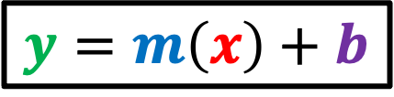
$$y=m\left(x\right)+b$$
Usually, we express the equation of a straight line like this, which is called the slope-intercept line form because the equation contains information about the slope and intercept of the line.
Snout Width
Size

Slide 4

$$y=m\left(x\right)+b$$
For example, this line is expressed as
$$y=0.5\left(x\right)+1$$
Snout Width
Since it intercepts the y-axis at 1 and has a slope of 0.5
Size

Slide 5

$$y=m\left(x\right)+b$$
If $m$ is zero and $b$ is 3, the line is expressed as
$$y=0\left(x\right)+3$$
$$y=3$$
Snout Width
Size

Slide 6
$$y=m\left(x\right)+b$$
How about this vertical line?
Snout Width
Size

Slide 7
$$y=m\left(x\right)+b$$
It turns out that that this form of equation cannot be used to describe a vertical line because the slope would be infinitely large
Snout Width
Size

Slide 8
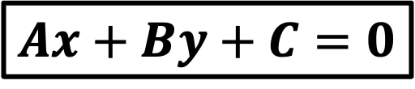
$$y=m\left(x\right)+b$$
This is one reason why we need to use the so-called “general form” of the equation for a straight line
Snout Width
$$Ax+By+C=0$$
Size

Slide 9
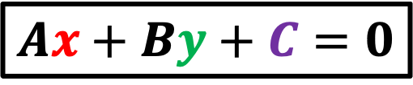
$$y=m\left(x\right)+b$$
$$Ax+By+C=0$$
Since vertical lines can be used to separate data points of two classes, the slope-intercept form to describe the line is not appropriate to use in SVM
Snout Width
Size

Slide 10
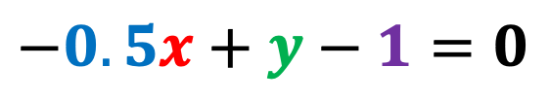
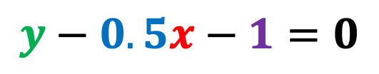
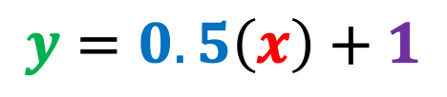
Suppose that we have the following line with a slope of 0.5 and intercept of one
$$y=0.5\left(x\right)+1$$
Snout Width
We will convert this equation to the general form
$$y−0.5x−1=0$$
$$−0.5x+y−1=0$$
Size

Slide 11
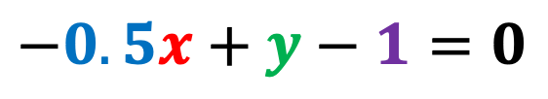
So that we have the following equation that describes the line in general form
$$−0.5x+y−1=0$$
Snout Width
Size

Slide 12
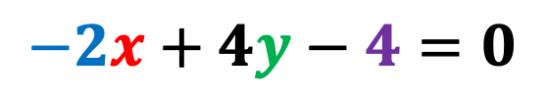
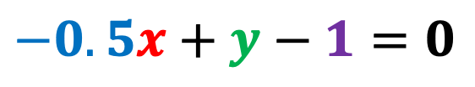
The coefficients are usually expressed as integers in this form
For example, if we multiply all terms by 4,
Snout Width
$$−0.5x+y−1=0$$
We get:
$$−2x+4y−4=0$$
Size

Slide 13
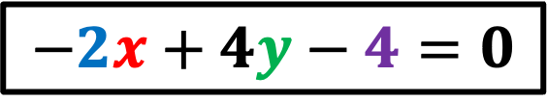

Both these equations describe the same line
$$−0.5x+y−1=0$$
Snout Width
$$−2x+4y−4=0$$
Size

Slide 14
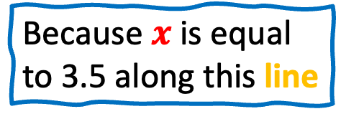

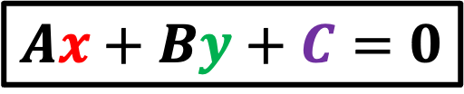
$$Ax+By+C=0$$
By using the general form, we can now describe the vertical line like this
Snout Width
$$x−3.5=0$$
Because $x$ is equal to 3.5 along this line
Size

Slide 15
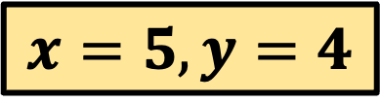
$$Ax+By+C=0$$
Another nice feature of the general form is that it can tell us which side of the line a data point is located on.
$$x=5,y=4$$
Snout Width
Size

Slide 16
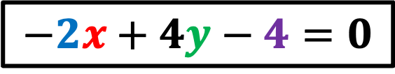
$$Ax+By+C=0$$
$$−2x+4y−4=0$$
$$x=5,y=4$$
Another nice feature of the general form is that it can tell us which side of the line a data point is located on.
Snout Width
Size

Slide 17
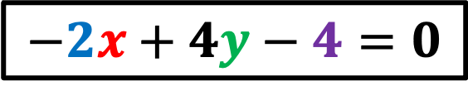


$$−2x+4y−4=0$$
If we plugin the x and y coordinates of this data point in our equation,
$$x=5,y=4$$
Snout Width
$$−2\left(5\right)+4\left(4\right)−4=0$$
$$−10+16−4=2$$
Size

Slide 18

$$−10+16−4=2$$
We see that it results in a value greater than zero, which in case means that the data point is above the line
$$x=5,y=4$$
Snout Width
Size

Slide 19
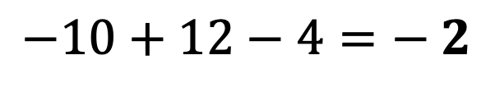

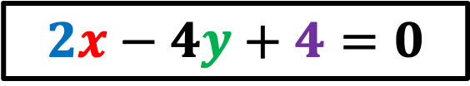
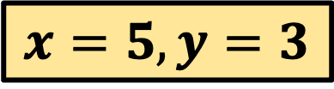
$$2x−4y+4=0$$
In comparison, this data point results in a negative value which tells us that the data point is below the line.
Snout Width
$$−2\left(5\right)+4\left(3\right)−4=0$$
$$x=5,y=3$$
$$−10+12−4=− 2$$
Size

Slide 20
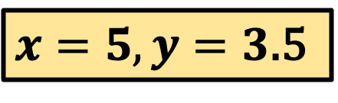


$$2x−4y+4=0$$
Note that any data point on the line will result in a value of zero
Snout Width
$x=5,y=3$.5
$$−2\left(5\right)+4\left(3.5\right)−4=0$$
$$−10+14−4=0$$
Size

Slide 21
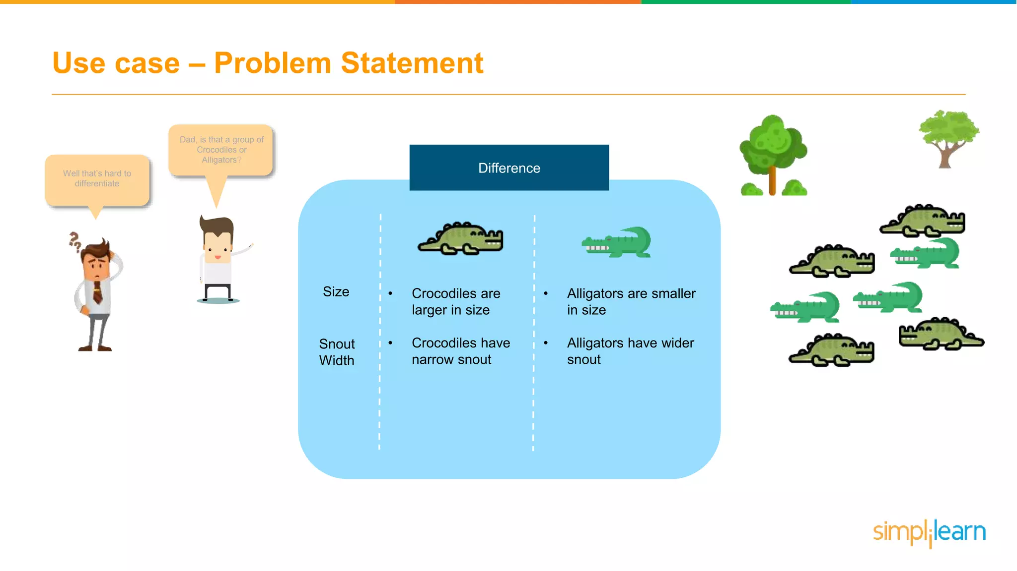
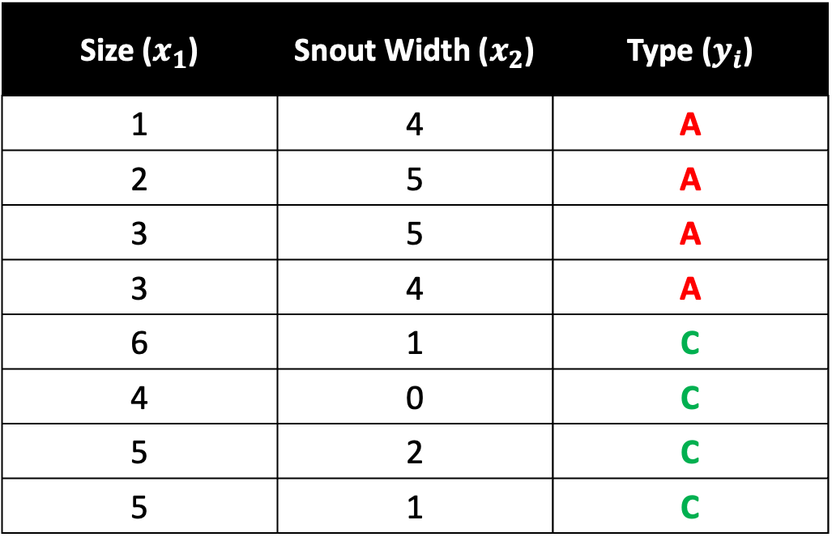
Size ($x_{1}$) | Snout Width ($x_{2}$) | Type ($y_{i}$)
1 | 4 | A
2 | 5 | A
3 | 5 | A
3 | 4 | A
6 | 1 | C
4 | 0 | C
5 | 2 | C
5 | 1 | C

Slide 22



$$w^{T}x−b=1$$
$$w^{T}x−b=0$$
Snout Width
$$w^{T}x−b=−1$$
Size

Slide 23






$$y=x−3$$
$$y−x=−3$$
$$−x+y=−3$$
Snout Width
$$−x+y+3=−3+3$$
$$−x+y+3=0$$
$$x−y+3=0$$
Size

Slide 24






$$y=x+1$$
$$y−x=1$$
$$−x+y=1$$
Snout Width
$$−x+y−1=1−1$$
$$−x+y−1=0$$
$$x−y+1=0$$
Size

Slide 25
Hard Margin
When the data is linearly separable, and we do not want to have any misclassifications, we use SVM with a hard margin.
Snout Width
Size

Slide 26
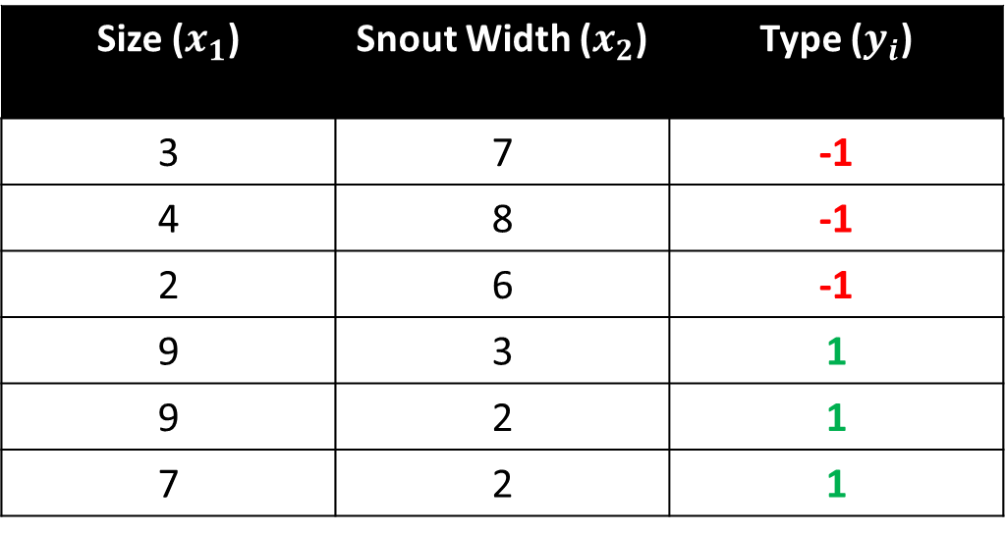
Crocodile and Alligator Example
Size ($x_{1}$) | Snout Width ($x_{2}$) | Type ($y_{i}$)
3 | 7 | -1
4 | 8 | -1
2 | 6 | -1
9 | 3 | 1
9 | 2 | 1
7 | 2 | 1

Slide 27
Snout Width
Size

Slide 28
-1
Snout Width
+1
Size

Slide 29



$\vec{w }$⋅ $\vec{x }$ - b = -1
Snout Width
$\vec{w }$⋅ $\vec{x }$ - b = +1
$\vec{w }$⋅ $\vec{x }$ - b = 0
Size

Slide 30


$\vec{w }$⋅ $\vec{x }$ - b = -1
Snout Width
$\vec{w }$⋅ $\vec{x }$ - b = +1
$\vec{w }$⋅ $\vec{x }$ - b = 0
$\vec{w_{1}}$ $\vec{x_{1}}$ + … + $\vec{w_{p}}$ $\vec{x_{p}}$ - b = 0
$$Hyperplane$$
Size

Slide 31

$$\vec{w }$$
Snout Width
Size

Slide 32
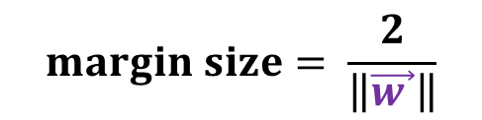
$$\vec{w }$$
Snout Width
$$margin size= \frac{2}{\left\|\vec{w }\right\|}$$
Size

Slide 33
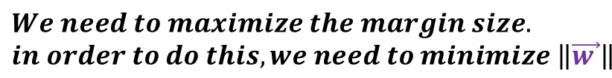
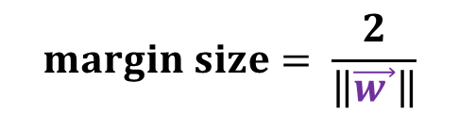

$$\vec{w }$$
Snout Width
$$margin size= \frac{2}{\left\|\vec{w }\right\|}$$
$$We need to maximize the margin size.$$
$$in order to do this, we need to minimize \left\|\vec{w }\right\|$$
Size

Slide 34
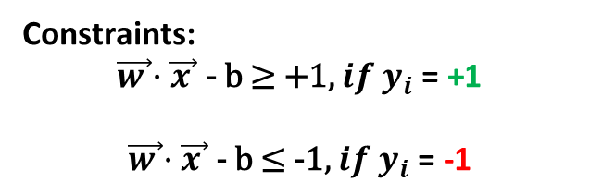
$$\vec{w }$$
Snout Width
$$margin size= \frac{2}{\left\|\vec{w }\right\|}$$
Constraints:
$$\vec{w }\text{⋅ }\vec{x }\text{ − }\text{b}\text{ ≥ +1, }{if y}_{i}\text{ = }\text{+1}$$
$$\vec{w }\text{⋅ }\vec{x }\text{ − }\text{b}\text{ ≤ −1, }if y_{i}\text{ = }\text{−1}$$
Size

Slide 35
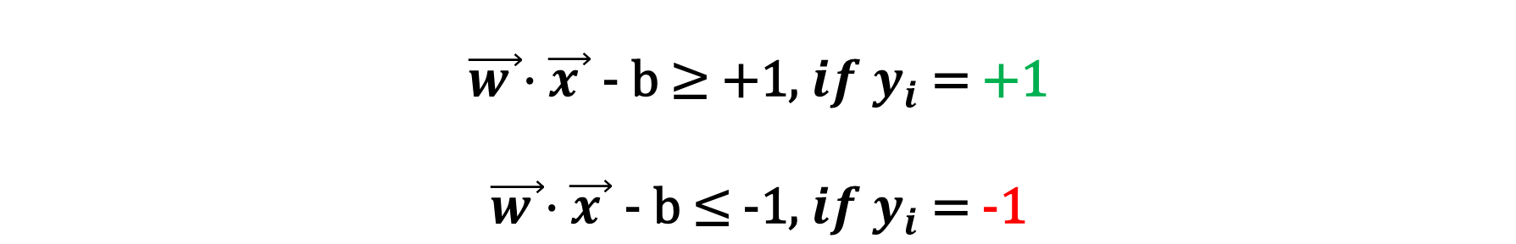
Hard Margin SVM Equation
$$\vec{w }\text{⋅ }\vec{x }\text{ − }\text{b}\text{ ≥ +1, }{if y}_{i}\text{ = }\text{+1}$$
$$\vec{w }\text{⋅ }\vec{x }\text{ − }\text{b}\text{ ≤ −1, }if y_{i}\text{ = }\text{−1}$$
These constraints state that each data point must lie on the correct side of the margin. These two conditions can be rewritten in a compact form
$$y_{i}\text{(}\vec{w}\text{ ⋅ } \vec{x_{i}}\text{ − }\text{b}\text{)} \text{≥ +1}$$

Slide 36

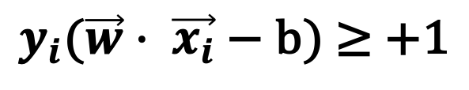
Hard Margin SVM Equation
$pick a w,b such that \left\|w\right\| is minimized$ while obeying the constraint
$$y_{i}\text{(}\vec{w}\text{ ⋅ } \vec{x_{i}}\text{ − }\text{b}\text{)} \text{≥ +1}$$
$$for all i=1, …, n$$

Slide 37

Outline
Hard Margin SVM
Soft Margin SVM

Slide 38
Soft Margin
When a linear boundary is not feasible, or we want to allow some misclassifications in the hope of achieving better generality, we can use SVM with a soft margin.
Snout Width
Size

Slide 39
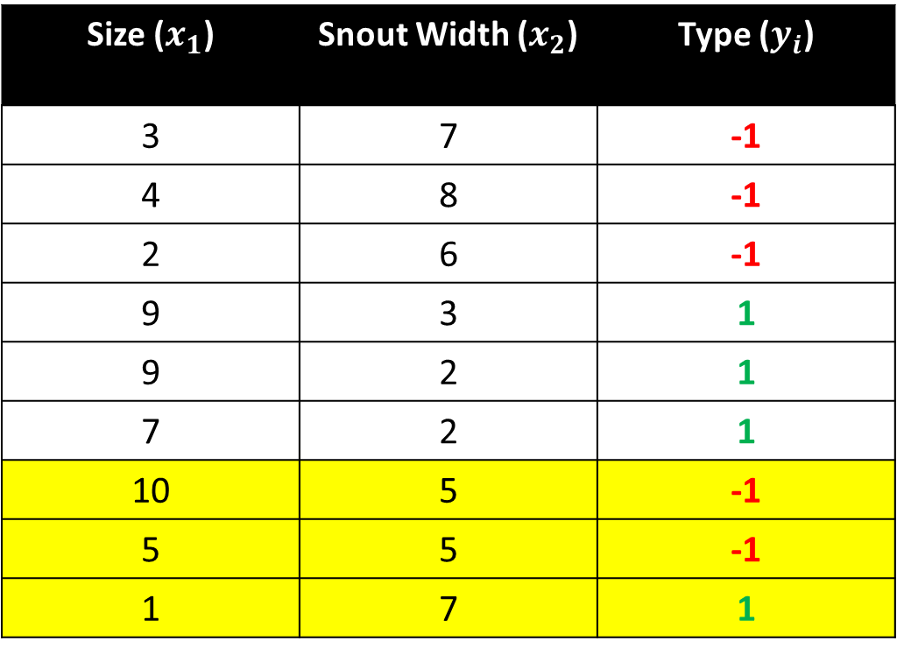
Crocodile and Alligator Example
Size ($x_{1}$) | Snout Width ($x_{2}$) | Type ($y_{i}$)
3 | 7 | -1
4 | 8 | -1
2 | 6 | -1
9 | 3 | 1
9 | 2 | 1
7 | 2 | 1
10 | 5 | -1
5 | 5 | -1
1 | 7 | 1

Slide 40




Snout Width
Size

Slide 41
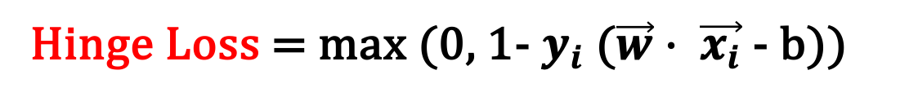
Loss Function
If we allow misclassifications to happen, we need to minimize the error and define a loss function. A loss function used for soft margin is the hinge loss.
Hinge Loss = max (0, 1- $y_{i}$ ($\vec{w}$ ⋅ $\vec{x_{i}}$ - b))

Slide 42



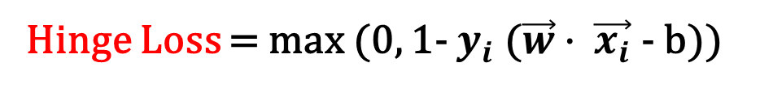
Loss Function
Hinge Loss = max (0, 1- $y_{i}$ ($\vec{w}$ ⋅ $\vec{x_{i}}$ - b))
Snout Width
max (0, 1 - 1( $>1$)) = 0
max (0, 1 + 1($<−1$)) = 0
max (0, 1 + 1($>1$)) = > 1
max (0, 1 + 1($Between 0 \& 1$)) = $Between 0 \& 1$
Size

Slide 43
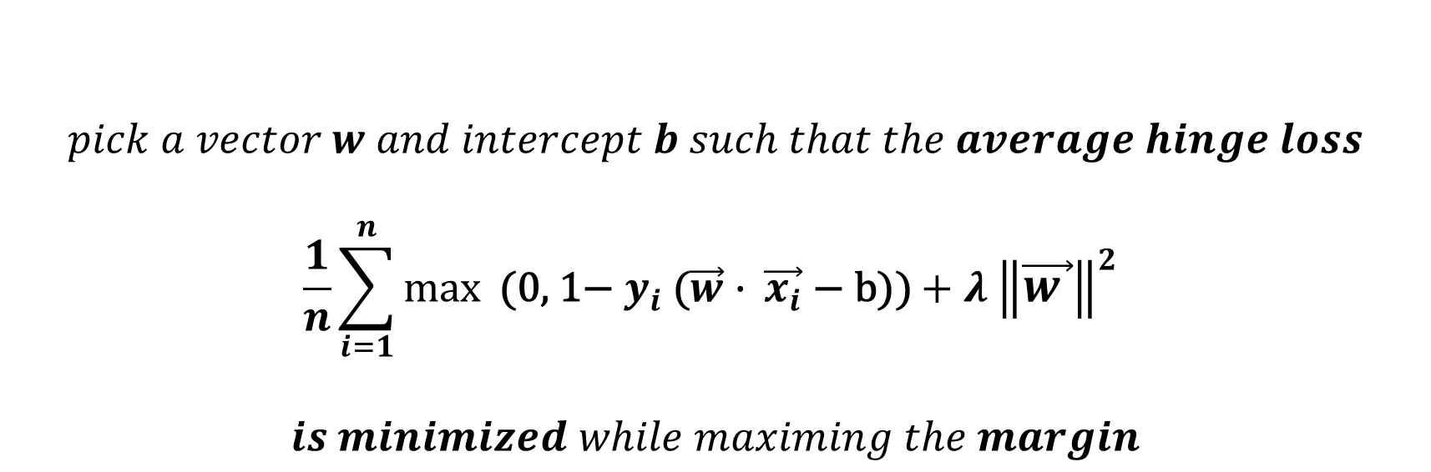
Soft Margin SVM Equation
$$pick a vector w and intercept b such that the average hinge loss$$
$$\frac{1}{n}\sum_{i=1}^{n}{max⁡\text{ (0, 1− }y_{i}\text{ (}\vec{w}\text{ ⋅ } \vec{x_{i}}\text{ − }\text{b}\text{))}}+λ {\left\|\vec{w }\right\|}^{2}$$
$$is minimized while maximing the margin$$
$Lambda (λ)$ is a positive parameter which determines the trade off between increasing the margin size and ensuring that $\vec{x_{i}}$ lie on the correct side of the margin.

